Slide 1
Transformer Reasoning Network for Personalized Review Summarization
Advisor: JIA-LING, KOH
Source: SIGIR 21
SPEAKER: Rui Ze Fang
DATE: 2022/02

Slide 2
Outline
Introduction
Method
Experiment
Conclusion

Slide 3
Introduction - Goal
User
Historical summary
Summary 1
Item
Summary
Summary 2
Rating
…..
Input = <review text, (userID, itemID, rating, historical summary)>
Output = summary

Slide 4
Introduction
user
過往評論
過往評論Summary
Historical summary :
由輸入的user and item過往的review summary所組成
Amazon dataset擁有每篇review對應一篇summary
user
item
rating
Notes:
Historical summary 會挑K組，選與input相同字最多前K個

Slide 5
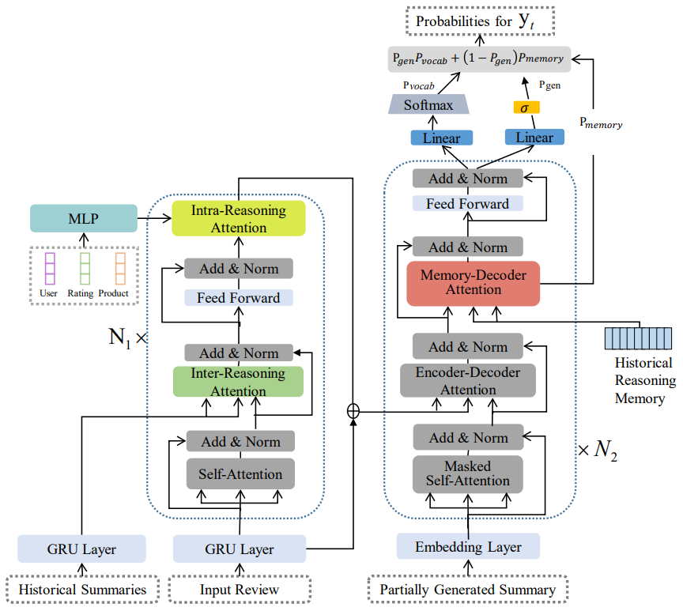
Framework
Intra-Reasoning attention
Inter-Reasoning attention
Review encoding

Slide 6
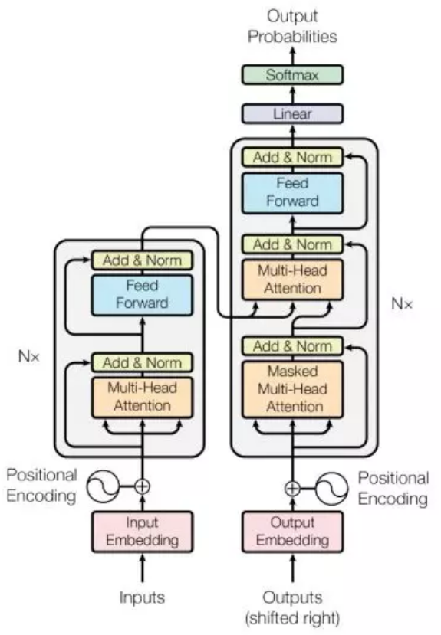

Slide 7
Method - Review encoding
Input review 以word為單位
Bi-directional GRU layer
=> H = {$h_{1}$, $h_{2}$, · · · , $h_{L}$}

Slide 8
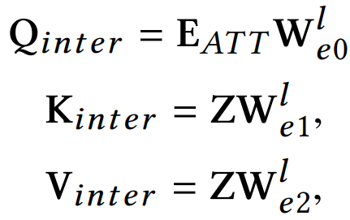
Method - Inter-Reasoning attention
Historical summaries
=> Z = {$z_{1}$, $z_{2}$, · · · , $z_{L^{′}}$}

Slide 9
Method - Intra-Reasoning attention
sigmoid

Slide 10
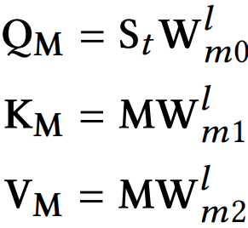
Method - Decoder
Historical reasoning memory
由Historical summaries中所有word的embedding組成
=> M = {$m_{1}$, $m_{2}$, · · · , $m_{|V_{d}|}$}

Slide 11
Method - Decoder

Slide 12
Loss function

Slide 13
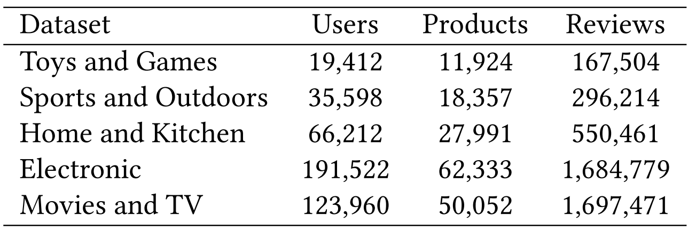
Experiment - Dataset

Slide 14
Experiment

Slide 15
Rouge
Rouge 1 = 6/6
Rouge 2 = 4/5
Generate sentence: the cat was found under the bed
Gold sentence: the cat was under the bed

Slide 16
Experiment
Notes:
HSSC與S2S相同,只是多預測rating
memAttr與這篇在encoder部分相同，decoder沒有memory
USN只使用user和這user過往的review和對應summary資訊，而且就只有在decoder計算attention影響生成
Dual-view與HSSC類似，multi-task想法預測語意和生成摘要
Transformer與S2S相同

Slide 17
Experiment

Slide 18
Experiment
L
2
-H | Inter-Reasoning attention, 直接到Intra-Reasoning attention
-G | Intra-Reasoning attention,沒加入[user,item,rating]資訊
-M | 去除Historical reasoning memory
-P | 沒有使用複製機制,不會從Historical reasoning memory挑字

Slide 19
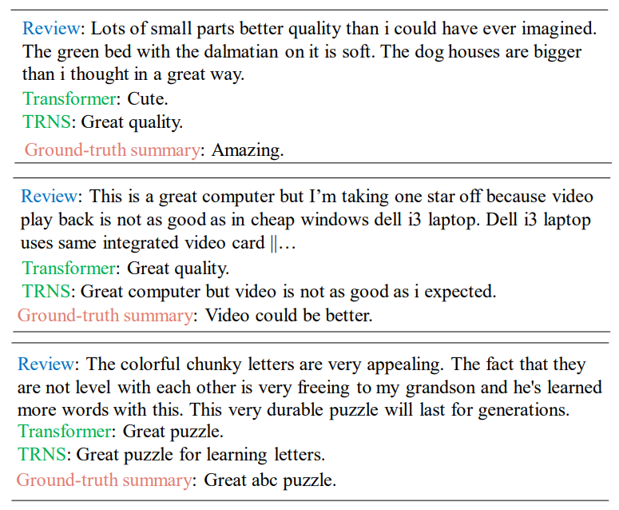
Experiment
Notes:
有提到aspect且更精確

Slide 20
Conclusion
propose a transformer-based reasoning network for personalized review summarization, which is able to effectively incorporate the historical summaries into the review summary generation.
historical reasoning memory from the historical summaries can alleviate the out-of-vocabulary problem.

